Slide 1
Move to a metropolis
Yi Yang
2/2020

Slide 2
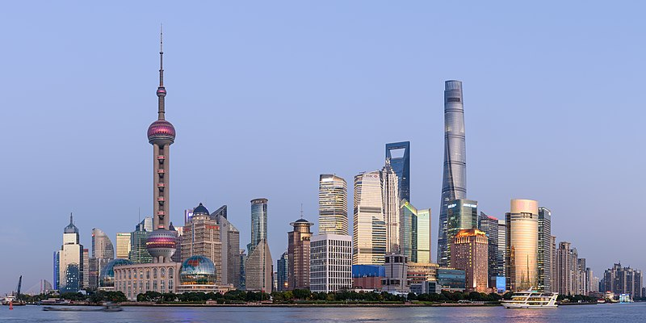
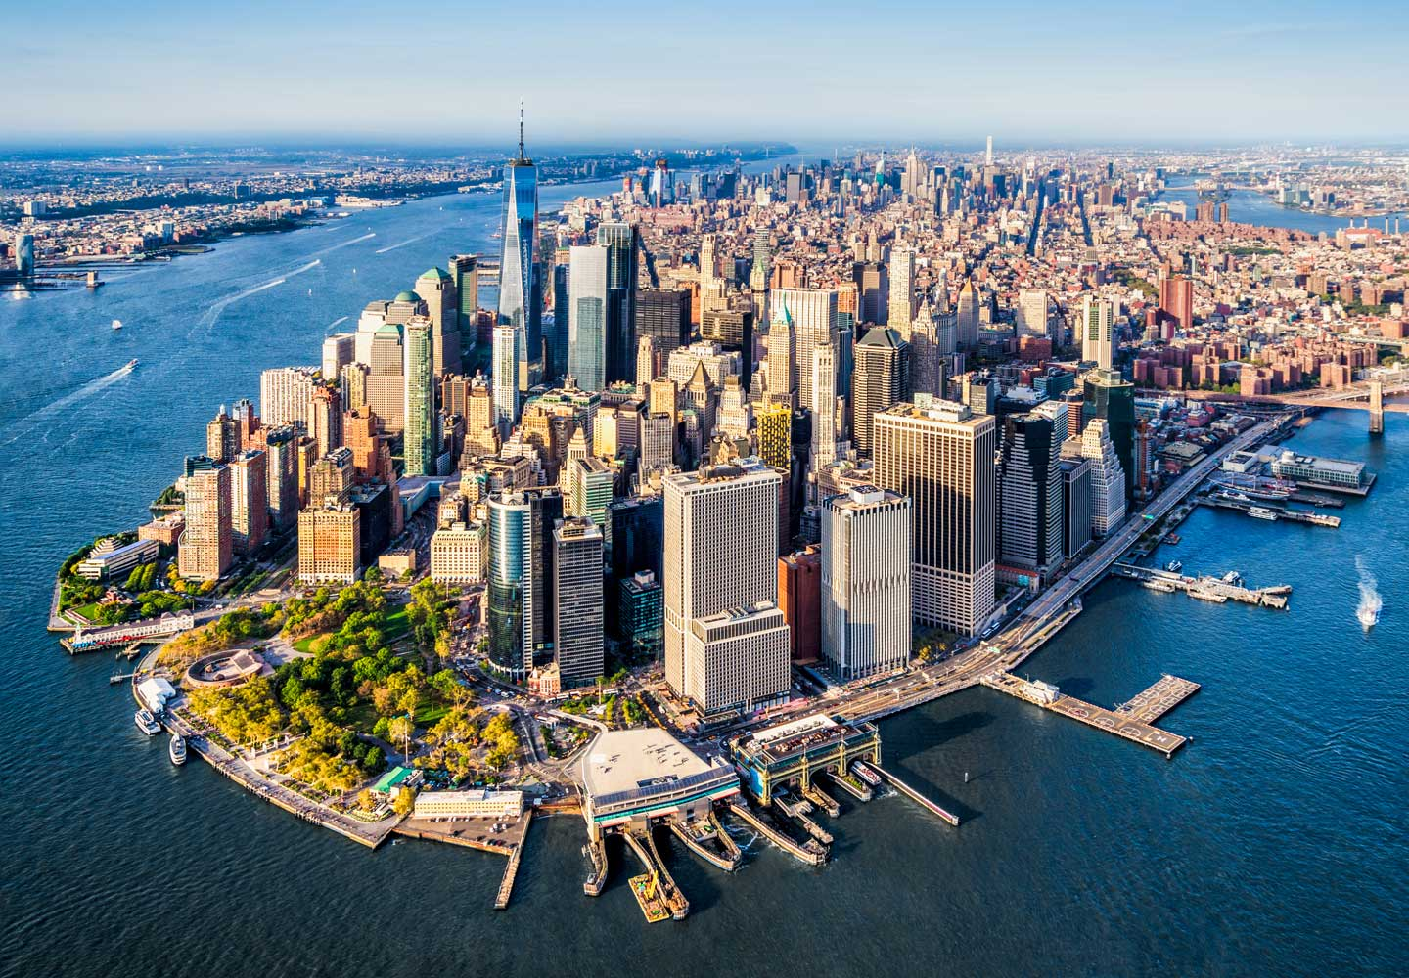
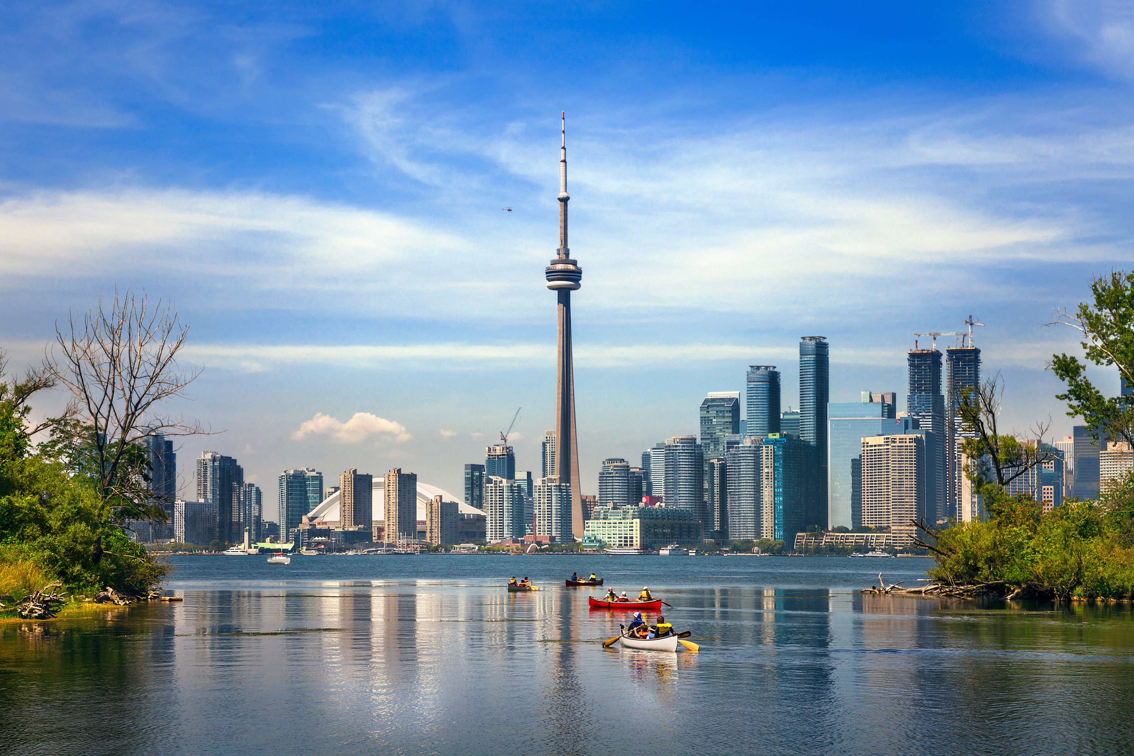
Introduction
New York City (NYC), Toronto, and Shanghai are all the financial centers of their respective countries and are all among the top 10 financial centers around the world.
How can we decide which one of the three will be a better choice for home?
SHANGHAI
TORONTO
NEW YORK CITY

Slide 3
Data acquisition and analysis
The geographic coordinates are obtained with Nominatim and geocoder by providing the address strings.
Venue data was pulled out with Foursquare API and clustering was done using kmeans clustering method.
SHANGHAI
TORONTO
NEW YORK CITY

Slide 4
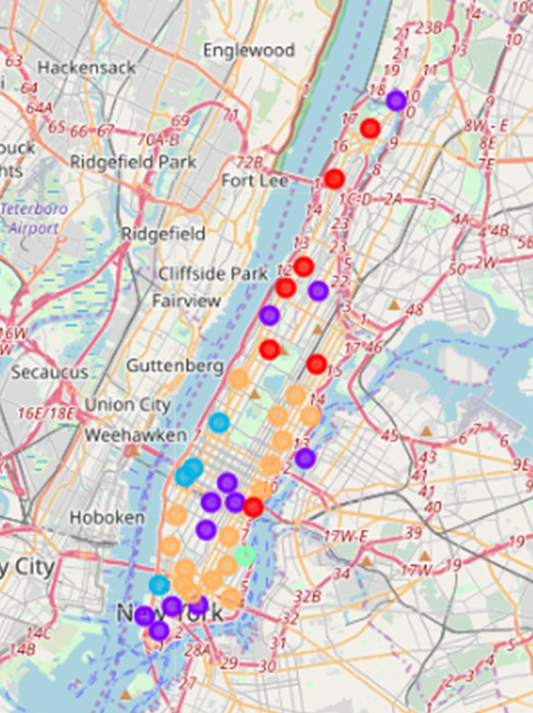
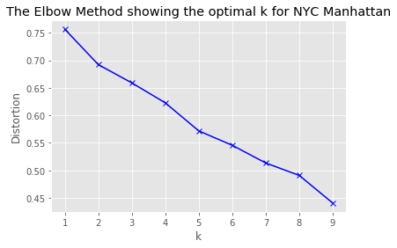
NYC Manhattan
Cluster 1
Cluster 4
Cluster 2
Cluster 5
Cluster 3
Cluster 1 and 5 are filled mainly with very diverse food and shopping options. In cluster 2 and 4, we can find neighborhoods with most parks. Cluster 3 is featured with theaters!

Slide 5
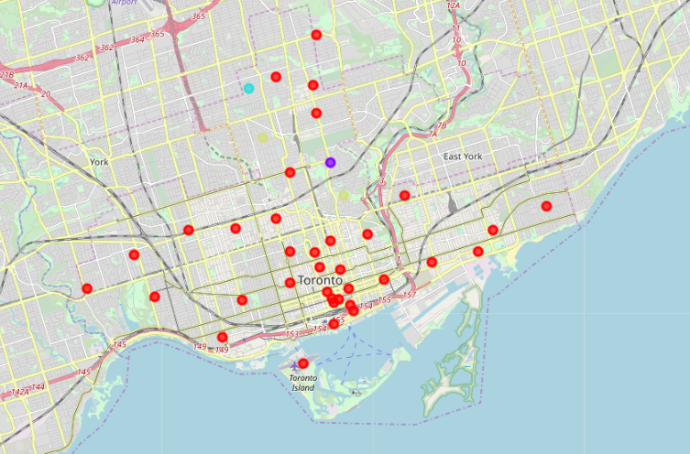
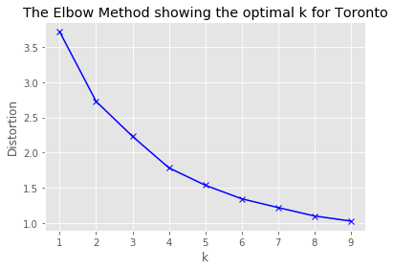
Toronto main area
Cluster 1 contains neighborhoods that are in urban areas. The rest of the clusters contain natural places such as parks, where people can enjoy themselves during weekends.
Cluster 1
Cluster 2
Cluster 3
Cluster 4

Slide 6
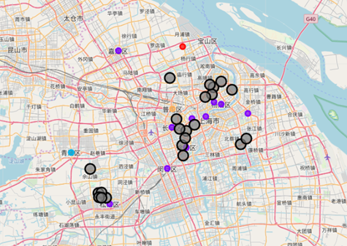
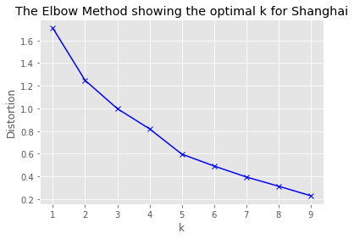
Shanghai main area
Clusters in Shanghai are not very distinguishable from each other. Mostly food and stores heavy.
Cluster 1, 3, 4, and 5 contain rural places such as farmers markets and flower shops.
Cluster 2 is possibly developed to fulfill
students’ need.
Cluster 1
Cluster 4
Cluster 2
Cluster 5
Cluster 3
University

Slide 7
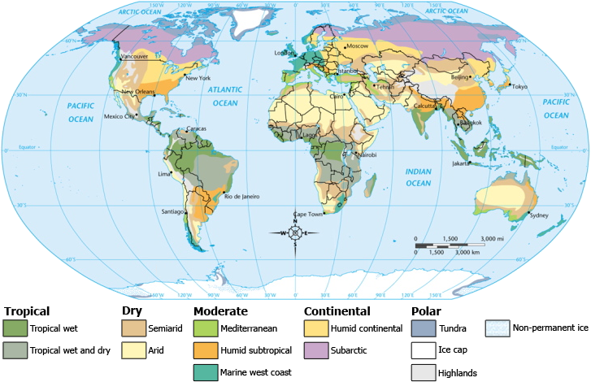
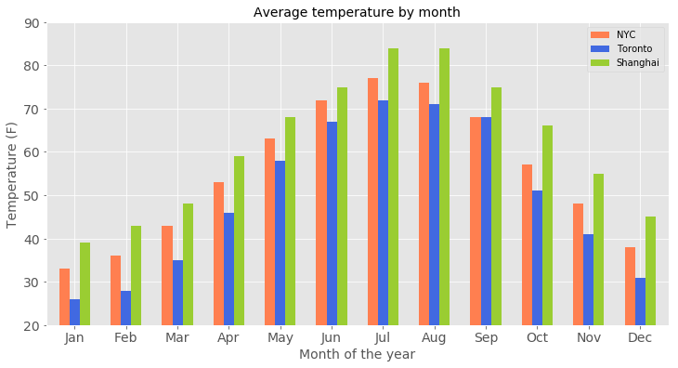
Average temperature
The three cities all see four seasons and a temperature change over 40 °F throughout the year, with Toronto being the coldest.

Slide 8
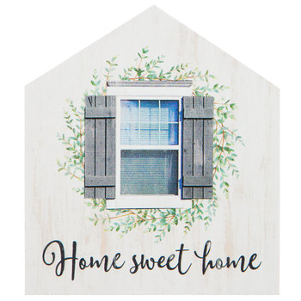
Conclusion
NYC offers the most diverse choices for people from any background. For those who would like to try new things everyday, this might be the top choice among the three.
Toronto is featured more for the balance between urban and natural areas. Even though NYC and Toronto both have park rich areas, the density of venues is much lower in Toronto, which makes it less crowded there.
For people who prefer warmer area or an extensive experience of asian culture, Shanghai is recommended.
“People will vote for their dream home with their feet by walking there.”
The final decision is up to everybody. Considering the location, food, climate, activities, and education, people will certainly find their unique lives.

